Slide 1
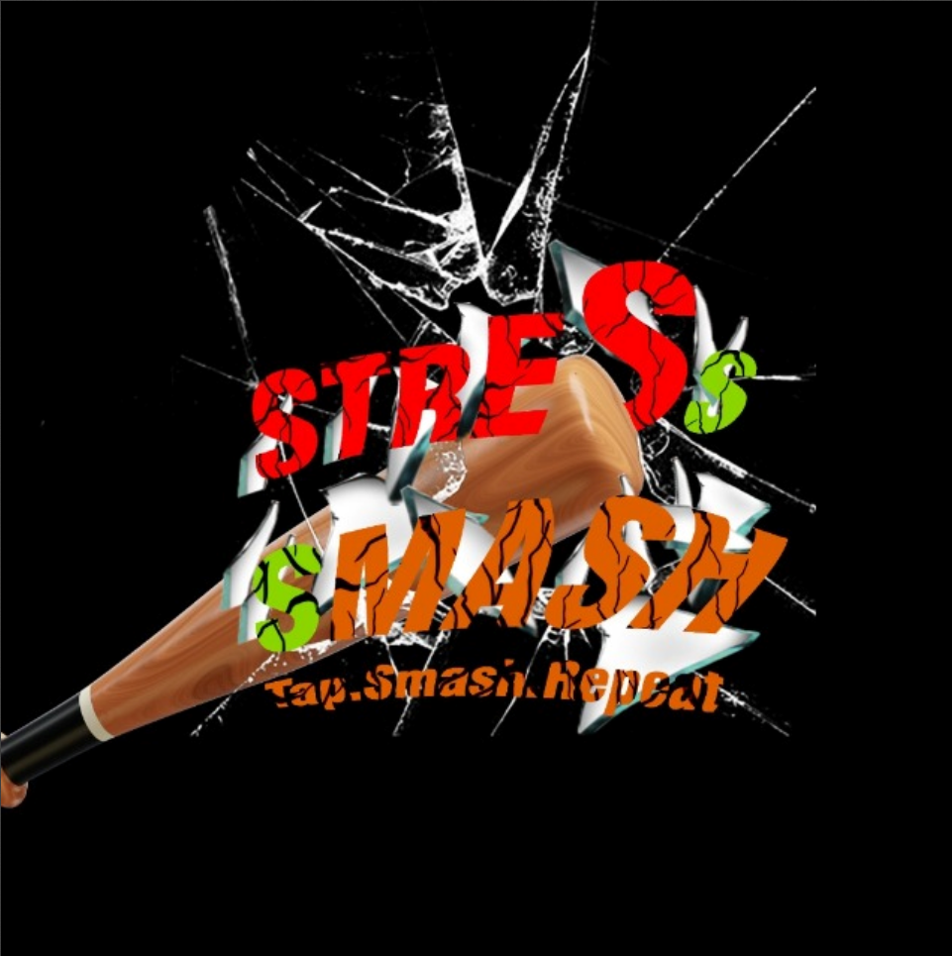
Stress Smash: Tap, Smash, Repeat!
Notes:
--- Welcome to the presentation on 'Stress Smash,' a mobile game designed specifically to alleviate stress and promote relaxation. This innovative game allows players to engage in enjoyable smashing activities while providing an outlet for stress relief.

Slide 2
TEAM MEMBERS & CONTRIBUTIONS – GROUP 3
SHANKARA NARAYANA VAMSHI – DESIGNER (VISUAL ASSETS, LEVEL DESIGN)
HARIOM – DEVELOPER (DEVELOPMENT)
ABHISHEK – DESIGNER (LEVEL DESIGN, LEVEL LAYOUT)

Slide 3
Game Design Document
Game Overview
Game Title: Stress Smash: Tap, Smash, Repeat!
Genre: Hyper-casual, Arcade
Theme: Office Space, Rage Room, Kitchen
Platform: Android
Target Audience: 12+, stress relief seekers, both genders
Game Engine: Unity
Perspective: 3D
Orientation: First-person view, Portrait, fixed camera
Gameplay
Core Mechanic: Tap/swipe to smash objects with precision before time runs out avoiding obstacles.
Objective:
Beat personal high scores.
Complete challenges.
Unlock new content (smashing tools, environments).
Compete on leaderboards.
Relieve stress.

Slide 4
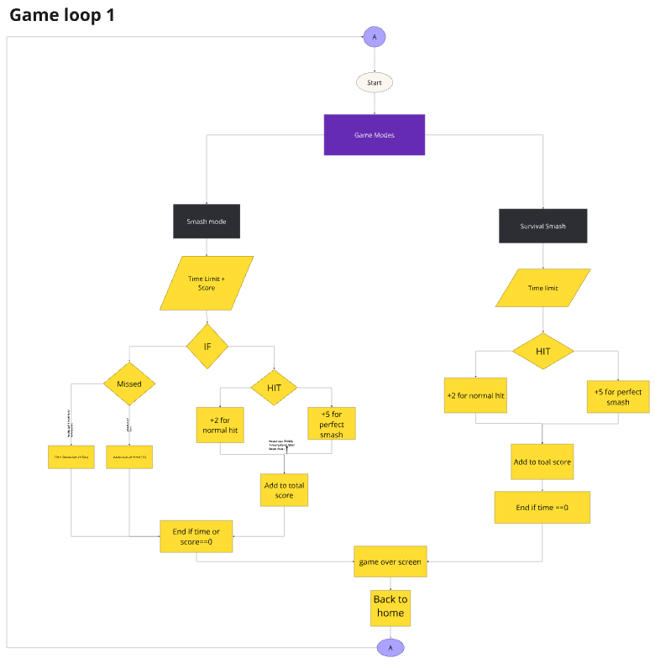
MIRO

Slide 5
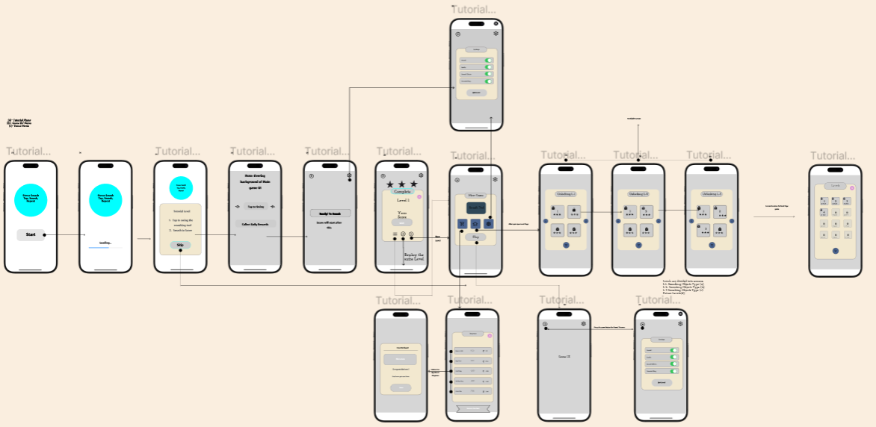
APP FLOW
FIGMA

Slide 6
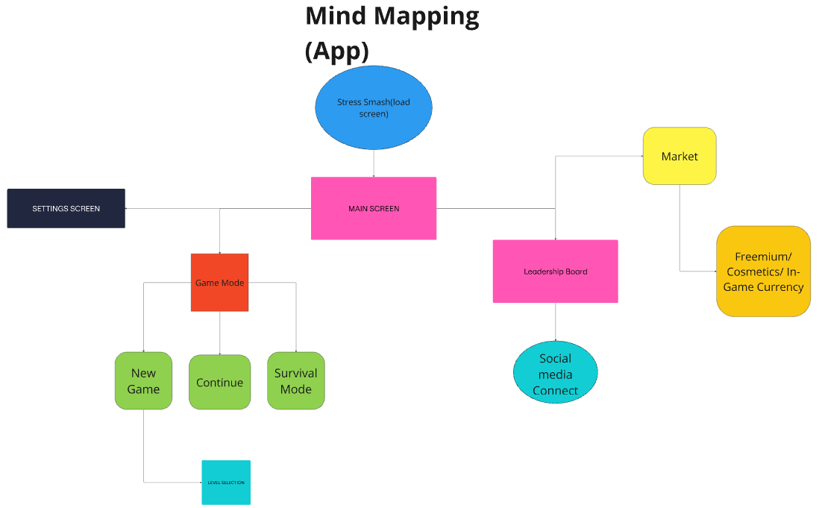
MIRO

Slide 7
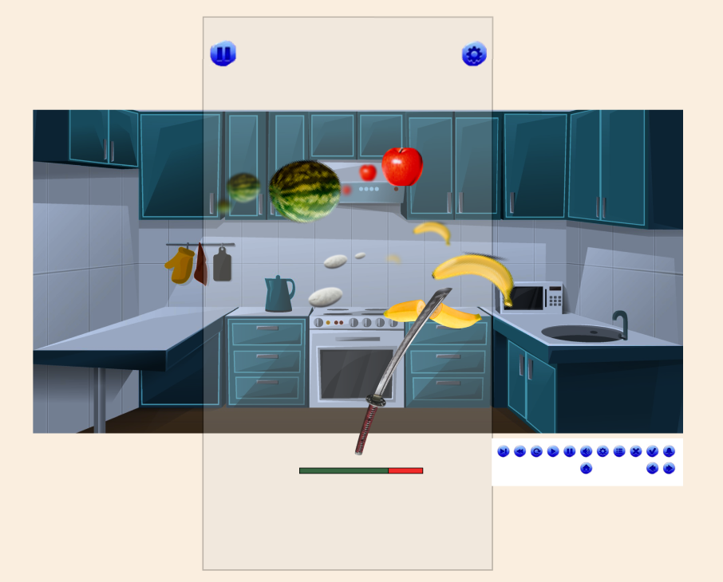
Game Play Screen

Slide 8
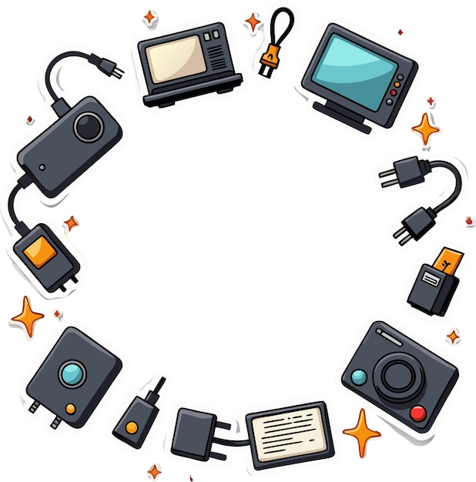

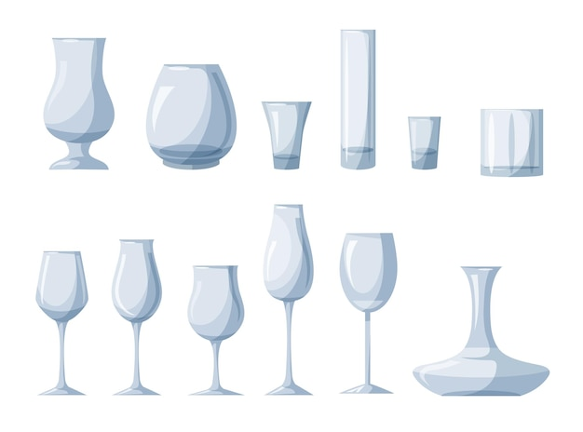
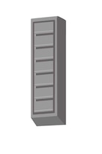
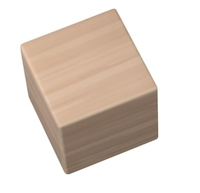
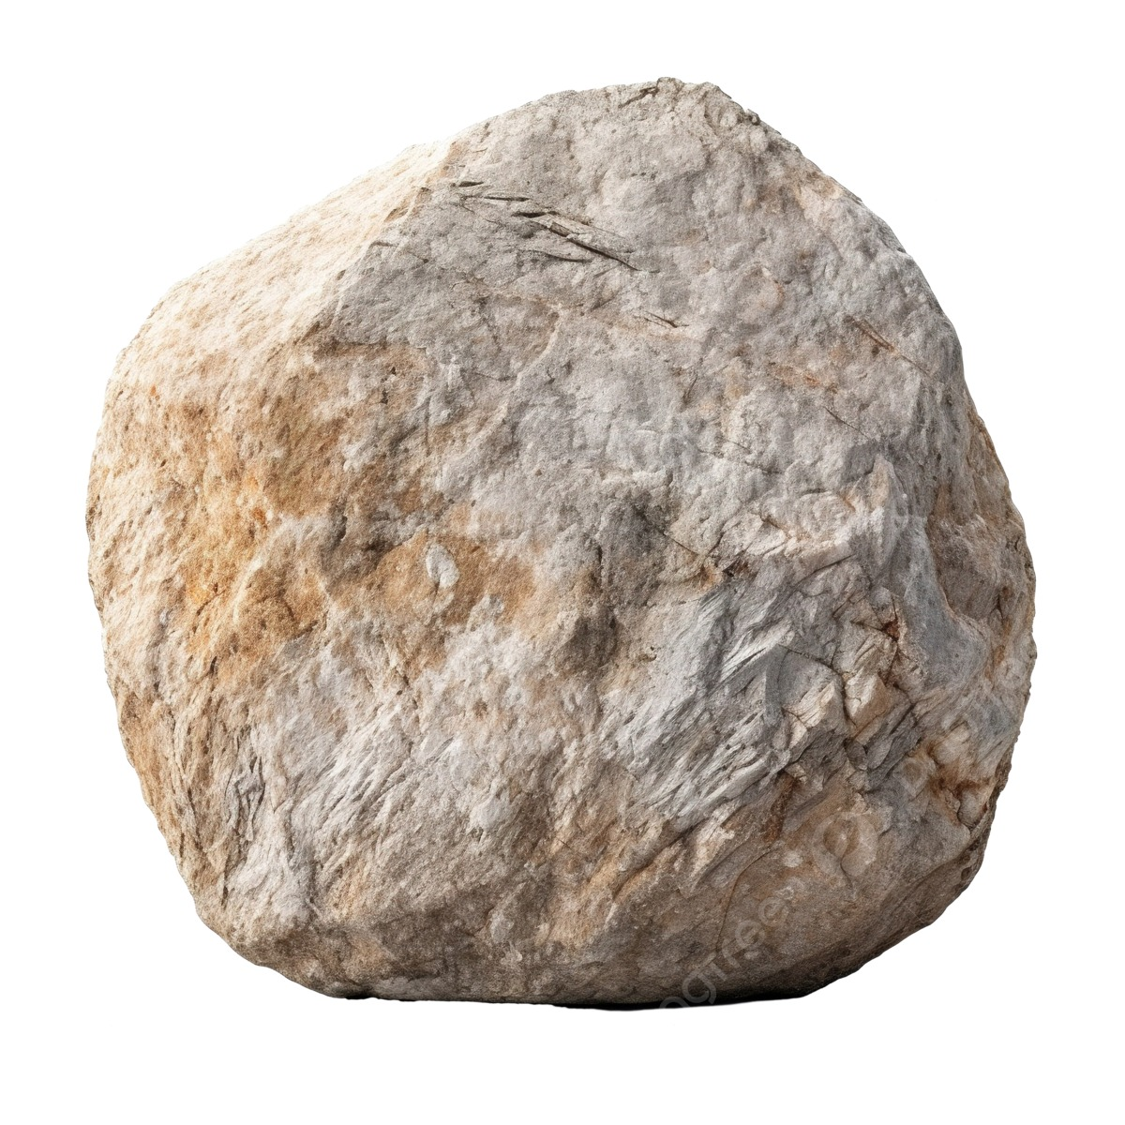
Types of Objects to Smash (Glass, Fruits, TV, Fridge, Etc.) Obstacles (Stone, Iron block, etc.,)
Variety of Objects
Fragile Items
Playful Targets

Slide 9
Difficulty Progression Plan
Level | Level Complexity | Object | Object behaviour | PowerUp | PowerUp Duration | Additional Challenges | Level Duration (Seconds) | Minimum Tap Count
1 | Easy | Fruits | Approaching towards player | Tool switch | 15 Seconds | - | 90 | 30 (1 tap for 1 object)
2 | Easy | Fruits, vegetables | Approaching towards player | Tool switch | 15 Seconds | STONES | 90 | 30 (1 tap for 1 object)
3 | Easy | Slime Balls | Approaching towards player | Tool switch | 15 Seconds | STONES | 80 | 30
4 | Medium | Multiple Slime Balls | Bouncing around the view | Slow-Mo, Tool switch | 10 seconds, 10 Seconds | STONES | 80 | 25
5 | Medium | Glass tumbler, Vases, | Falling from above | Slow-Mo, Shield, Tool switch | 10 seconds, each | IRON BLOCKS | 60 | 25
6 | Medium | Glass bottles, Tabletops | mixed behaviours | Combo multiplier (*2), Tool switch | 10 seconds | IRON BLOCKS | 50 | 25

Slide 10
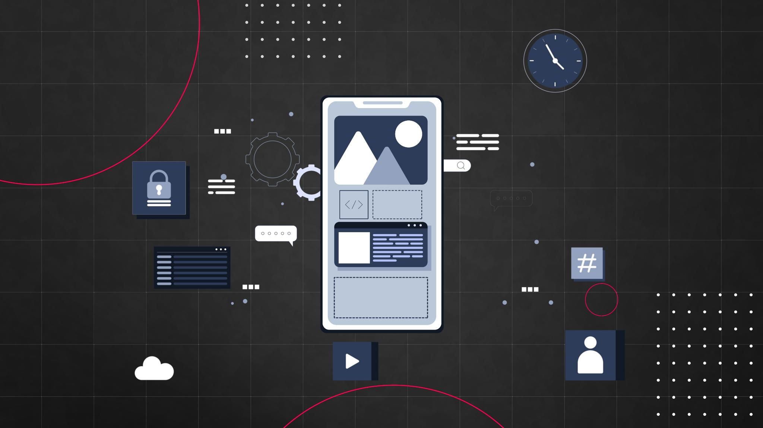
Game Development Process
Concept Design
Prototyping
Testing Phase
Iteration

Slide 11
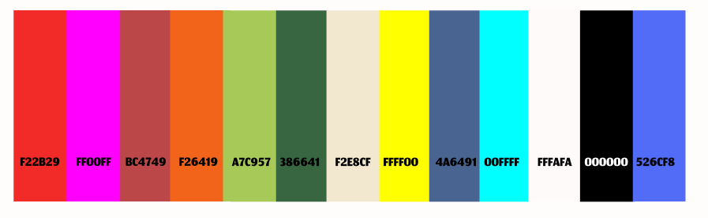
Graphics and Visual Design
Vibrant Color Palette
Playful Design Elements
Engaging Visual Aesthetics

Slide 12
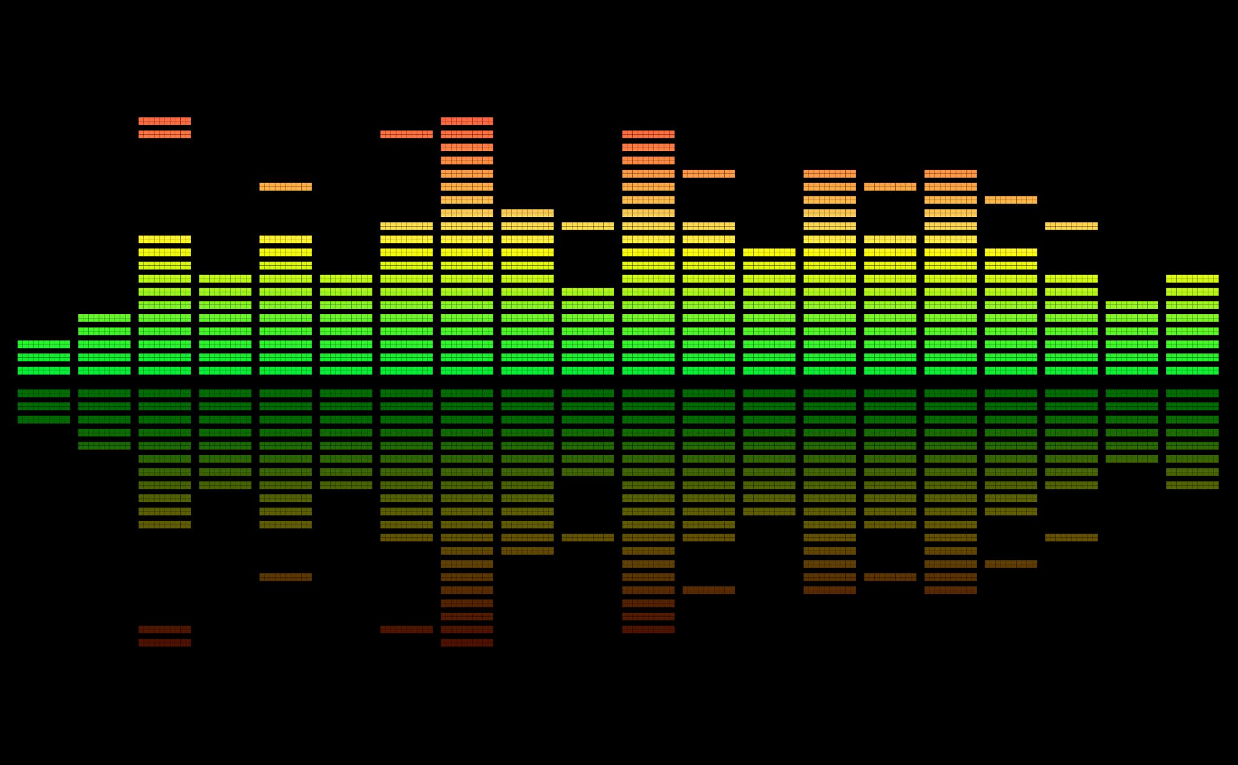
Sound Effects and Music
Importance of Sound Effects
Satisfying 8D Audio Feedback

Slide 13
Information architecture (IA)
1. Entry Point (Startup Flow)
Unity Splash Screen → Displays the Game Engine followed by Game Logo & loading screen.
2. Main Menu & Navigation
Home Screen
Play Button to start the game, Settings Icon for customization.
Levels Screen
Displays available levels., Some levels appears to be locked which requires progress to unlock.
3. Gameplay & HUD
Main Gameplay Screen
Displays the Smashing tool and control buttons (“Switch tool" & “powerups"), Health System of a tool is indicated by green and red bars.
Pause Menu
Options: Resume, Restart, Settings, Quit, accessible during gameplay.
4. Game Results (Win/Loss Screens)
⭐⭐⭐ (30 objects in a level 1, (90 seconds) )
⭐⭐ (20 objects smashed within a minute will get 2 stars.)
⭐ (10 or more objects smashed will get 1 star)
If a player completes level within a minute with perfect 30 objects smashed will get 3 stars, 30 objects with more than 60 sec will get 2 stars.
Level Failed
If “10 or less objects smashed” will get level failed.
5. Settings Menu
Options include:
Sound Toggle
Music Toggle
8D Audio

Slide 14
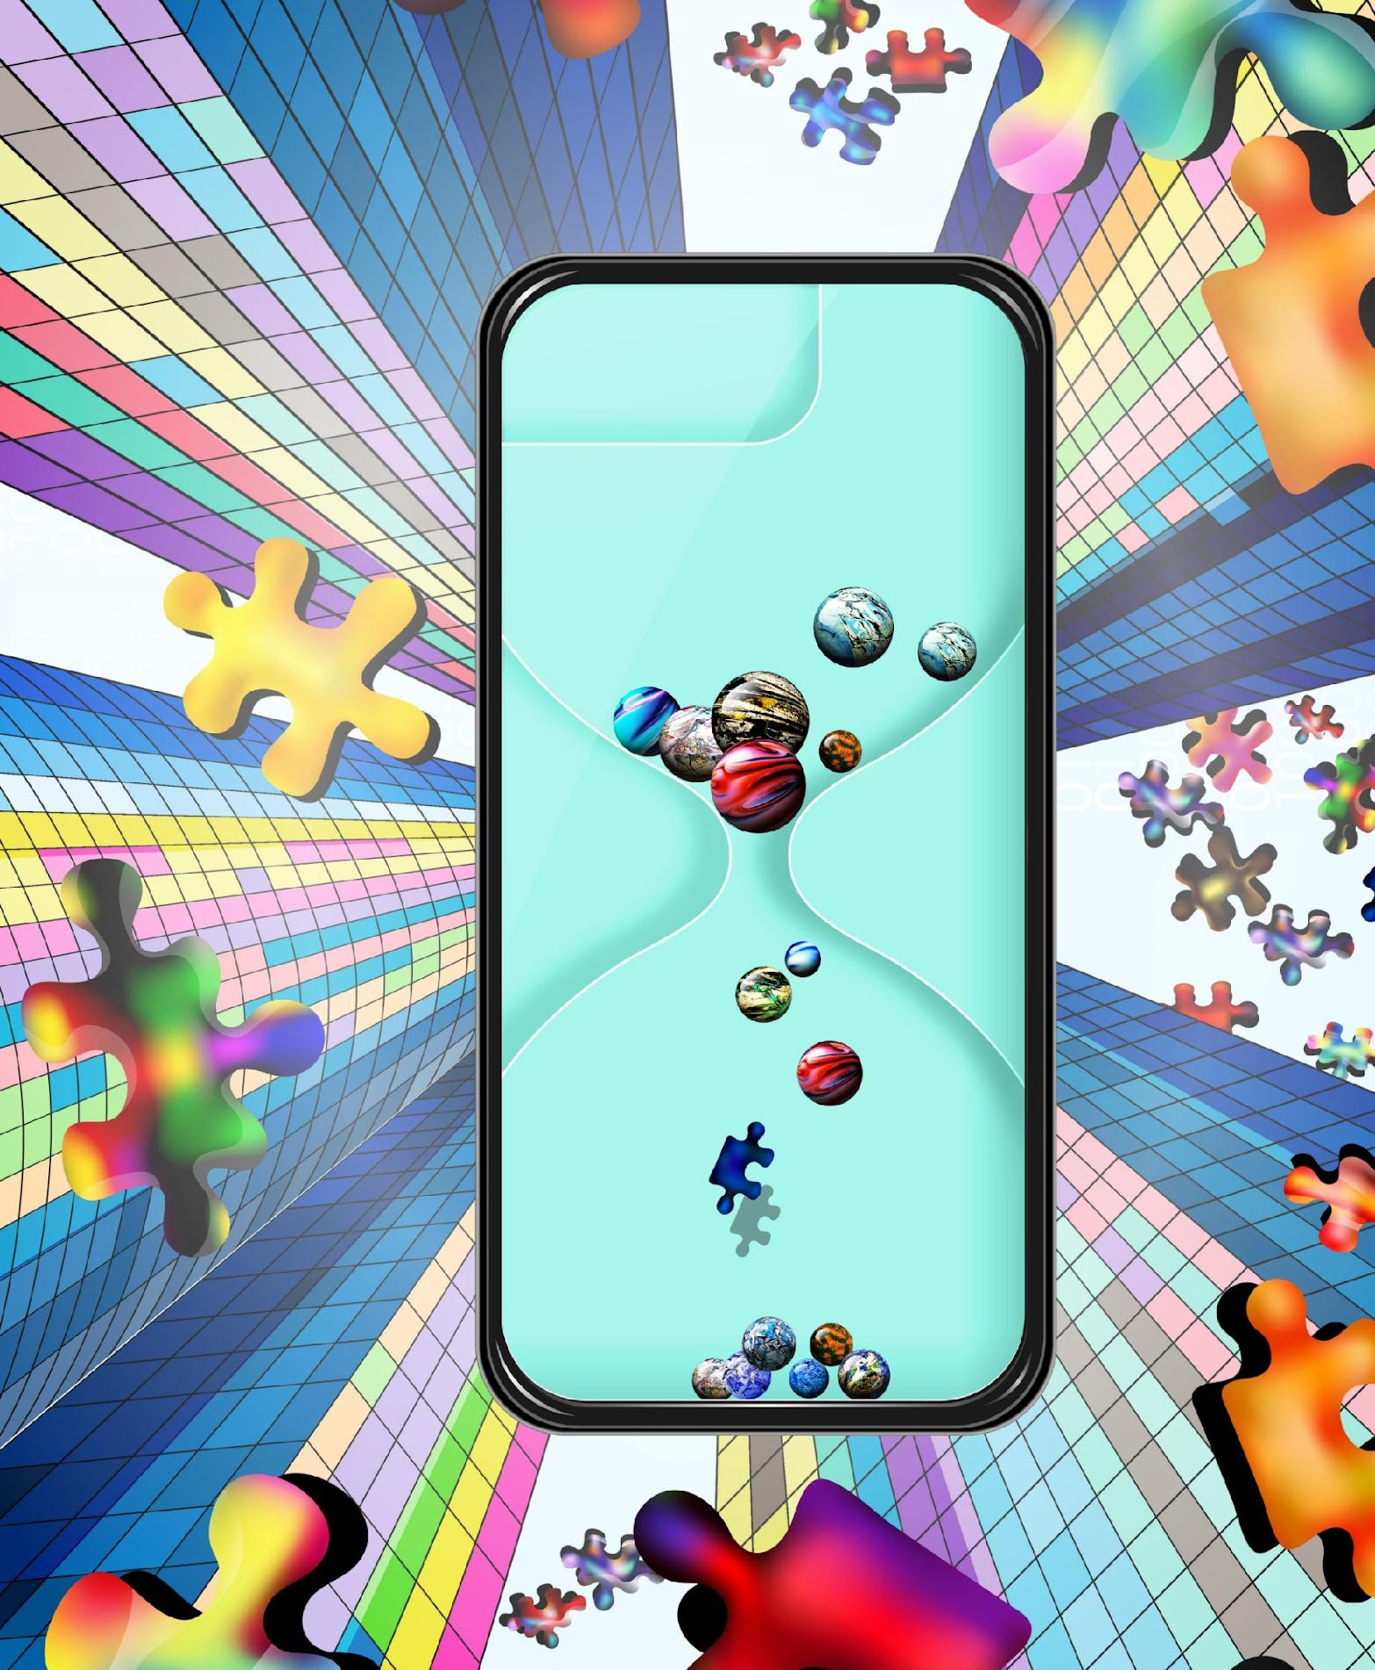
Engagement and Entertainment Value
Engaging Gameplay
Unique Game Mechanics
Stress Relief Aspect

